Slide 1
In Data Veritas – Data Driven Testing for Distributed Systems
Authors: Data Infrastructure Team, LinkedIn
Presenter: Ramesh Subramonian

Slide 2
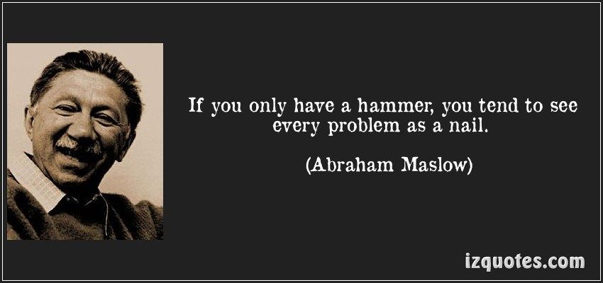
Testing is an exercise in data analysis

Slide 3
The Holy Trinity of Testing
Instrument
Simulate
Analyze

Slide 4
Instrumentation
Examples
Log files, HTTP proxies, journaling triggers
Tracers
Leave footprints behind but tread gently
Problems
“Heisenberg’s Uncertainty Principle”
Notes:
Example problem when testing streaming media sever. Under heavy load, there was “bad” behavior every 8000 seconds. This was because of log file rotation

Slide 5
Simulation
Stress the system
Production usage => realistic stress
Chaos Monkey style random walks
Traditional action-reaction tests

Slide 6
Analysis
Collect the data from the various probes
Parse and load it into a relational database
Express desired system behavior as invariants
Invariants can be
Performance related
Correctness related
Negative statements e.g., this should not happen

Slide 7
Advantages of Data Driven Testing
“Knowledge Management”
You can’t have a bug if you don’t have a spec
“Provability”
Useful when bugs are hard to reproduce
Usable in production
Production usage provides inputs for testing analyses

Slide 8
Weaknesses of Data Driven Testing
Ease of acquiring data with sufficient fidelity
Requiring engineers to emit the right “signals”
Need to be creative to push system to its limits
Most significantly, requires a cultural change
Your partners – architects, engineers, product managers – should not be afraid of being challenged

Slide 9
Specific Use Case - Helix
Helix is a generic cluster management framework used for the automatic management of partitioned, replicated and distributed resources hosted on a cluster of nodes. (SOCC 2012)
See http://helix.incubator.apache.org
Used at LinkedIn for:
Distributed Data Serving Platform (SIGMOD 2013)
Search as a Service

Slide 10
Overview of Helix
Database is divided into partitions P1, P2, …
Partitions replicated – P1 replicated as P11, P12
Replicas distributed over nodes M1, M2,…
Every replica has a state e.g., master, slave, …
Helix's responsibility to manage the state of the replicas, subject to constraints placed by the user at configuration time.

Slide 11
Instrumentation for Helix
Zookeeper group membership and change notification used to detect and record state changes.
Zookeper logs parsed into CSV files and loaded as tables

Slide 12
Initial log file

Slide 13
Structured log file – list of tables
config.csv
currentState.csv
externalView.csv
healthReportDefaultPerfCounters.csv
idealState.csv
liveInstances.csv
stateModelDefStateCount.csv
messages.csv
stateModelDefStateNext.csv

Slide 14
Structured Log File - sample
timestamp | partition | instanceName | sessionId | state
1323312236368 | TestDB_123 | express1-md_16918 | ef172fe9-09ca-4d77b05e-15a414478ccc | OFFLINE
1323312236426 | TestDB_123 | express1-md_16918 | ef172fe9-09ca-4d77b05e-15a414478ccc | OFFLINE
1323312236530 | TestDB_123 | express1-md_16918 | ef172fe9-09ca-4d77b05e-15a414478ccc | OFFLINE
1323312236530 | TestDB_91 | express1-md_16918 | ef172fe9-09ca-4d77b05e-15a414478ccc | OFFLINE
1323312236561 | TestDB_123 | express1-md_16918 | ef172fe9-09ca-4d77b05e-15a414478ccc | SLAVE
1323312236561 | TestDB_91 | express1-md_16918 | ef172fe9-09ca-4d77b05e-15a414478ccc | OFFLINE
1323312236685 | TestDB_123 | express1-md_16918 | ef172fe9-09ca-4d77b05e-15a414478ccc | SLAVE
1323312236685 | TestDB_91 | express1-md_16918 | ef172fe9-09ca-4d77b05e-15a414478ccc | OFFLINE
1323312236685 | TestDB_60 | express1-md_16918 | ef172fe9-09ca-4d77b05e-15a414478ccc | OFFLINE
1323312236719 | TestDB_123 | express1-md_16918 | ef172fe9-09ca-4d77b05e-15a414478ccc | SLAVE
1323312236719 | TestDB_91 | express1-md_16918 | ef172fe9-09ca-4d77b05e-15a414478ccc | SLAVE
1323312236719 | TestDB_60 | express1-md_16918 | ef172fe9-09ca-4d77b05e-15a414478ccc | OFFLINE
1323312236814 | TestDB_123 | express1-md_16918 | ef172fe9-09ca-4d77b05e-15a414478ccc | SLAVE

Slide 15
Example Invariant
Each database partition must have
(ideally) 1 instance that is in state “master”
(ideally) 2 instances that are in state “slave”
Never more than 1 instance in state “master”
Never more than 2 instance in state “slave”

Slide 16
No more than R=2 slaves
Time | State | Number Slaves | Instance
42632 | OFFLINE | 0 | 10.117.58.247_12918
42796 | SLAVE | 1 | 10.117.58.247_12918
43124 | OFFLINE | 1 | 10.202.187.155_12918
43131 | OFFLINE | 1 | 10.220.225.153_12918
43275 | SLAVE | 2 | 10.220.225.153_12918
43323 | SLAVE | 3 | 10.202.187.155_12918
85795 | MASTER | 2 | 10.220.225.153_12918
Invariant “apparently” violated.
Testing is an ongoing dialogue – the “Socractic method”

Slide 17
How long was it out of whack?
Number of Slaves | Time | Percentage
0 | 1082319 | 0.5
1 | 35578388 | 16.46
2 | 179417802 | 82.99
3 | 118863 | 0.05
83% of the time, there were 2 slaves to a partition
93% of the time, there was 1 master to a partition
Number of Masters | Time | Percentage
0 | 15490456 | 7.164960359
1 | 200706916 | 92.83503964

Slide 18
Moral of the story?
The spec is never as simple as it seems
Let the data talk to you

Slide 19
More stuff to do
Improve simulation to explore search space more efficiently?
How does one characterize difference?
Bringing time into the equation
Convert quasi-random testing to deterministic tests?

Slide 20
Last Words - Dijkstra
The only effective way to raise the confidence level of a program significantly is to give a convincing proof of its correctness.
It is psychologically hard in an environment that confuses between love of perfection and claim of perfection and by blaming you for the first, accuses you of the latter

Slide 21
Appendix: Q
Q is a column-store relational database with its own “vector” language (think APL)
Tiny footprint: ½ MB code
Highly optimized for single machine execution
IPP, MKL, Cilk, multi-threaded, vectorized, GPU…
Every operation
Reads one or more fields from one or more tables
Produces
one or more fields in a single table
Scalar value(s)

Slide 22
Examples of Q operators
shift:
T[i].f2 := T[i+n].f1
w_is_if_x_then_y_else_z:
if T[i].fx then T[i].fw := T[i].fy else T[i].fw :=T[i].fz
sortf1f2: T f1 f2 A_ f1’ f2’
T[i].f1’ <= T[i+1].f1’
Forall i, exists j: T[j].f1 = T[i].f1’ and T[j].f2 = T[i].f2’

Slide 23
Why Q?
Let your boat of life be light, packed with only what you need… You will find the boat easier to pull then, and it will not be so liable to upset, and it will not matter so much if it does upset; good, plain merchandise will stand water. You will have time to think as well as to work.
Three Men in a Boat, Jerome K. Jerome

